Slide 1

2026 Investor Relations
Global Solution Provider

Slide 2

Table of Contents
01
Dongjin Semichem Highlight
02
Prologue
History & Governance
Global Network
03
Core Business & Competitiveness
Semiconductor Materials
Display Materials
Green Energy
Growth Strategy & Momentum
04
Financial Performance
Financial Summary
Financial Structure
Shareholder Return
05
Appendix

Slide 3


Dongjin Semichem Highlight
Breaking Through the Limits of Sub-Nanometer Processing
Dongjin Semichem, A Global Advanced
Materials Solutions Provider
ㅋ
Sole-Source Supplier with a Strong Technology Moat (Commercial
Production of EUV Photoresist)
U.S. Market Expansion:
Unlocking Long-Term Secular
Growth Drivers
Successfully achieved Korea's first commercial-scale production of EUV photoresist, establishing a strong technology moat in a market historically dominated by Japanese suppliers.
Our flagship KrF photoresist holds a dominant market position, with demand supported by the increasing layer counts of 3D NAND.
Our general-purpose thinner benefited from the semiconductor upcycle, supporting resilient growth in semiconductor materials despite weaker NAND demand in 2024–2025.
We are strengthening our position in the global semiconductor supply chain via establishing both thinners and ultra-high-purity sulfuric acid facilities by investing approximately USD186m(KRW260bn) since 2H22.
Scheduled to begin commercial production in 2H26, the Texas thinner facility is expected to supply to foundry customer's local fab.
Our joint venture with Samsung C&T and Martin for high-purity sulfuric acid is well positioned to benefit from U.S. policies promoting domestic supply-chain localization.
3 2026 Investor Relations

Slide 4
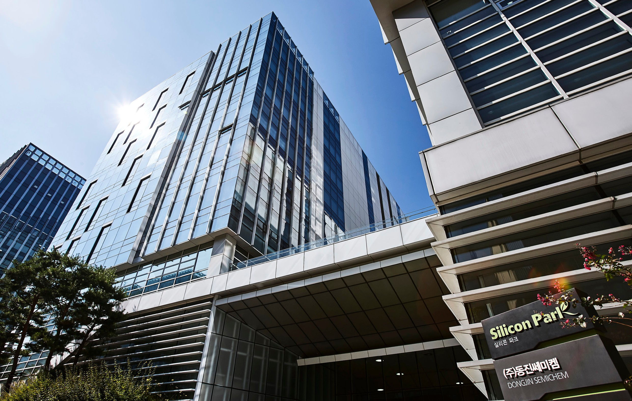
Prologue
History & Governance
Global Network
Notes:
<이미지>
반도체 공정 과정 관련

Slide 5

01. Prologue
History & Governance
Over the past half-century, Dongjin Semichem has consistently expanded its footprint as a dedicated pioneer in the fine chemical materials sector.
Challenge / Bold Ambition
Growth & Advancement
Quantum Leap &
Global Management
Next-Era Expansion
Proprietary Foaming Agent
Development
Foaming Agent Business
Expansion
Entry into Electronic Materials
Electronic Materials Business
Expansion
International Market Entry
Building Foundations for
Future Growth
Surpassing KRW 1 Trillion
in Revenue
Semiconductor Materials
Market Expansion
Entry into the Secondary
Battery Materials Market
Fine Chemical Materials
Specialist
Global Footprint Expansion
Building a Sustainable
Growth Engine
1967
1989
2007
2020 ~
Founded in 1967 in Foaming Agents, Premier Leader in Fine Chemicals
Notes:
<표로 만들어서> (시대별 사진 추가)

Slide 6
01. Prologue
History & Governance
14,572
FY2025 Revenue :
Reflects the impact of discontinued operations related to the planned divestiture of the China display subsidiary
14,081
Top-Line Trend
13,099
(Unit: KRW 100M)
11,613
11,941
9,378
8.8%
7,093
CAGR Since 2010
4,229
2,458
Crossing the KRW 1T Milestone
1,322
FY2021 Revenue
00
05
10
15
20
21
22
23
24
25
6 2026 Investor Relations
Notes:
<표로 만들어서> (시대별 사진 추가)

Slide 7
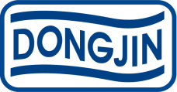
01. Prologue
History & Governance
Dongjin Semichem Technology (Qidong) Co., Ltd.(100.0%)
CHENGDU DONGJIN SEMICHEM CO., LTD.(100.0%)
HEFEI DONGJIN SEMICHEM CO., LTD.(100.0%)
DONGJIN SEMICHEM(XI'AN) SEMICONDUCTOR MATERIALS CO., Ltd.(100.0%)
CHONGQING DONGJIN SEMICHEM CO., LTD.(100.0%)
HUIZHOU DONGJIN SEMICHEM CO., LTD.(100.0%)
FUZHOU DONGJIN SEMICHEM CO., LTD.(100.0%)
Dongjin Global Holdings. LTD. (100.0%)
Dongjin Holdings
32.5%
SINAM REFINED FUEL.CO.,LTD. (99.5%)
Dongjin Sweden AB (97.3%)
SICHUAN DONGJIN SEMICHEM CO., LTD.(100.0%)
WUHAN DONGJIN SEMICHEM CO., LTD.(100.0%)
Taiwan Dongjin Semichem Co.,Ltd.(89.4%)
DONGJIN USA INC (100.0%)
BEIJING DONGJIN SEMICHEM CO.,LTD. (100.0%)
DONGJIN INNOCHEM
(Post Spin-off)
(Electronic Materials)
DONGJIN SEMICHEM TEXAS, INC. (100%)
DSM SEMICHEM LLC (70%)
ORDOS DONGJIN SEMICHEM CO.,LTD.(100.0%)
7 2026 Investor Relations

Slide 8
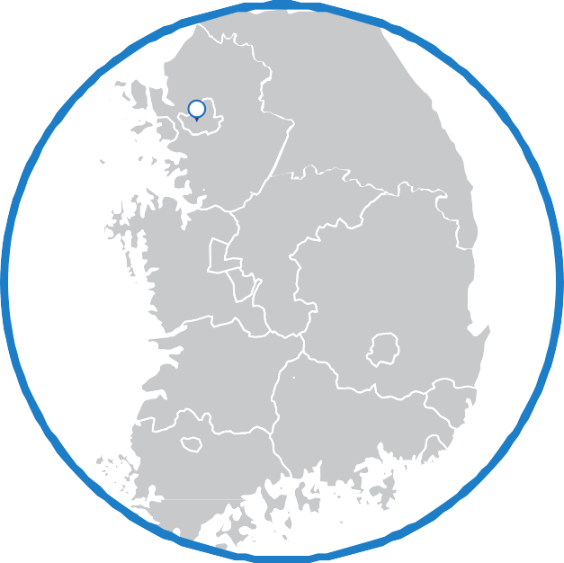
01. Prologue
Global Network - Office/Factory
Sweden
DONGJIN SWEDEN AB
China
BEIJING DONGJIN SEMICHEM CO.,LTD.
Dongjin Semichem Technology (Qidong) Co., Ltd.
CHENGDU DONGJIN SEMICHEM CO., LTD.
HEFEI DONGJIN SEMICHEM CO., LTD.
DONGJIN SEMICHEM(XI'AN) SEMICONDUCTOR MATERIALS CO., Ltd.
ORDOS DONGJIN SEMICHEM CO.,LTD.
CHONGQING DONGJIN SEMICHEM CO., LTD.
HUIZHOU DONGJIN SEMICHEM CO., LTD.
FUZHOU DONGJIN SEMICHEM CO., LTD.
SICHUAN DONGJIN SEMICHEM CO., LTD.
WUHAN DONGJIN SEMICHEM CO., LTD.
Shenzhen Office
Seoul
Seoul HeadQuarters
Gyeonggi-do
Bal-an Factory
Incheon Factory
Si-hwa Factory
Pangyo R&D Center
Paju Office
Gyeongsang
buk-do
Gumi Office
Chungcheong
buk-do
Eumseong Plant
Dongjin Advanced Materials Co., Ltd.
Chungcheong
nam-do
SINAM REFINED FUEL.CO.,LTD.
USA
DONGJIN USA INC
DSM SEMICHEM LLC
DONGJIN SEMICHEM Texas INC
Taiwan
Taiwan Dongjin Semichem Co.,Ltd.
Indonesia
PT. DONGJIN INDONESIA
18 Global Sites | 5 Regional Offices
4 Domestic Sites | 4 Offices | 1 Central R&D Center
8 2026 Investor Relations

Slide 9






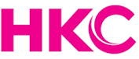



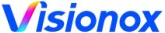
01. Prologue
Global Network - Clients
KOREA
LG Display
LG INNOTEK
LG Electronics
SAMSUNG Electronics
SAMSUNG Display
SAMSUNG SDI
SK hynix
SK KEYFOUNDRY
MAGNACHIP
DB HITEK
CHINA
USA
BOE
Visionox
CSOT
Truly
HKC
SAMSUNG
SK hynix
LG Display
Tianma
SMIC
CXMT
HHG
GLOBAL FOUNDRIES
SAMSUNG Electronics
TAIWAN
UMC
MXIC
AUO
INNOLUX
SOUTHEAST
ASIA
JAPAN
SHARP
SILTERRA
SSMC

Slide 10
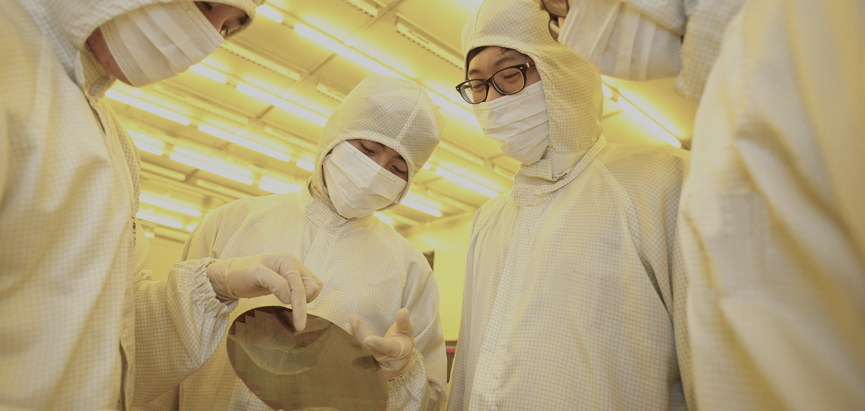
Core Business &
Competitiveness
Semiconductor Materials
Display Materials
Growth Strategy & Momentum
Why Invest

Slide 11


02. Core Business & Competitiveness
Semiconductor Materials
Through continuous R&D in advanced materials and core semiconductor process technologies, we firmly anchor and power the world-leading Korean semiconductor industry
Main Product Portfolio
Photoresist
Thinner
CMP Slurry
Anti-Reflective Coating
Hardmask
Precursor
Sulfuric Acid
Korea's First 1M Photoresist Development
First in Korea to Develop & Commercialize CMP Slurry
First in Korea to Commercialize ArF Immersion Photoresists
Global No. 1 in 3D NAND KrF Photoresists
No. 1 Domestic Market Share in Semiconductor Thinners
Semiconductor Thinner
No. 1 Market Share in Korea
Business Overview
Starting with semiconductor encapsulants in 1984, Dongjin Semichem developed Korea's first photoresist in 1989 and has successfully mass-produced EUV photoresist. Today, we supply a comprehensive portfolio of semiconductor process materials to leading global customers.
By driving localization of imported critical materials, Dongjin actively competes with global leaders while strengthening the core foundation of Korea's semiconductor industry through advanced material innovation.
11 2026 Investor Relations

Slide 12
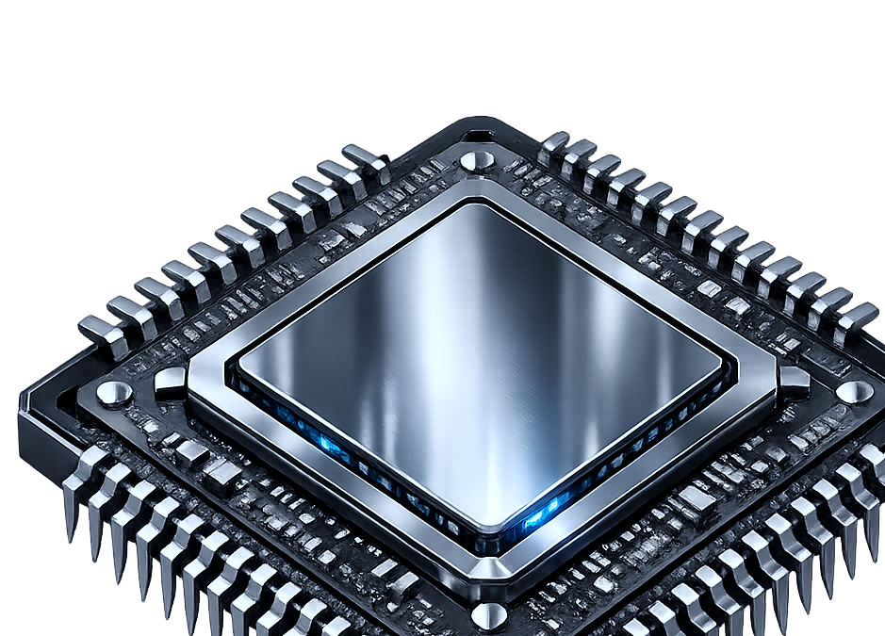
02. Core Business & Competitiveness
Semiconductor Materials
Key Product Portfolio
01. Photoresist
Photoresist is a photosensitive material that undergoes chemical changes when exposed to specific wavelengths of light, enabling the precise transfer of patterns onto a substrate. It is a critical material used in the lithography process for semiconductor device manufacturing.
02. CMP Slurry
CMP is an advanced polishing technology that achieves ultra-precise planarization of wafer surfaces by combining chemical reactions via slurry with mechanical abrasion. Slurries are categorized by target film type—primarily Oxide, Metal, and Organic (Polymer) slurries—and are further specialized based on abrasive chemistry and targeted functional applications.
03. Thinner
Semiconductor Thinner is applied in Edge Bead Removal (EBR) to eliminate unnecessary photoresist along the silicon wafer edges following spin coating. It is also utilized in the Resist Reduced Coating (RRC) process to minimize photoresist consumption during dispense. Compared to conventional thinners, Dongjin’s proprietary thinner reduces photoresist usage by up to 50% while minimizing hump height, significantly driving wafer yield enhancement.
12 2026 Investor Relations

Slide 13
02. Core Business & Competitiveness
Semiconductor Materials
04. Bottom Anti-reflective
Anti-Reflective Coating (ARC) is a critical material in the photolithography process that controls bottom-surface light reflection and scattering. By effectively suppressing process defects such as standing waves and reflective notching, it enables high-precision fine-pattern formation.
05. Spin-on-carbon Hardmask
With thinner PR films required for sub-nanometer scaling, PR alone cannot withstand aggressive etch processes. This material serves as an advanced etch mask, acting as a vital enabler for next-generation semiconductor manufacturing
06. Sulfuric Acid
High-Purity Sulfuric Acid is blended with high-purity hydrogen peroxide at precise ratios for use in the Sulfuric Peroxide Mixture (SPM) cleaning step of semiconductor wet processing. It plays a critical role in thoroughly removing organic residues—such as photoresist remnants—and metallic impurities.
07. Precursor
Precursors serve as essential source materials for ultra-high-quality CVD and ALD thin-film deposition processes. They enable the deposition of metal films, as well as metal/silicon oxide and nitride films, with superior step coverage across complex device architectures.
13 2026 Investor Relations

Slide 14
02. Core Business & Competitiveness
Display Materials
Dongjin Semichem launched its display materials business in 1991 to power the rapid growth of South Korea’s LCD industry
Main Product Portfolio
Organic Insulating Layer
Materials
Photoresist
Stripper
Etchant
Color Resist
Back-Electrode Materials
Hard Coating
OC, PR
CPL, HTL Prime
Optically Clear Resin
Korea's First Organic Insulator Development
Korea's First LCD Photoresist Development
World's First 4-Mask PR Mass Production
Korea's First LCD PR Stripper Development
World's First In-Cell Touch Back-Electrode Commercialization
Organic Insulating Material
No. 1 Market Share in Korea
Business Overview
Despite global and Japanese competitors holding proprietary core technologies, Dongjin Semichem successfully localized key process materials—including Photoresists, Strippers, Etchants, and Thinners—through proprietary R&D, significantly enhancing cost efficiency and global competitiveness for South Korea’s display industry.
Moving beyond import substitution, Dongjin has continuously driven material innovations tailored for process miniaturization, yield enhancement, and workflow optimization. By developing next-generation and cost-efficient materials, we continue to serve as a key growth catalyst for the display ecosystem.
14 2026 Investor Relations

Slide 15
02. Core Business & Competitiveness
Display Materials
Key Product Portfolio
01. Organic Insulating Layer Materials
It prevents crosstalk between transparent pixel electrodes and data lines in TFT circuits, enabling pixels to overlap adjacent data lines. This significantly expands the panel’s aperture ratio and drives substantial brightness (luminance) enhancement.
02. Photoresist
A functional polymer compound that undergoes chemical reaction upon exposure to specific light wavelengths. By leveraging changes in its physical and chemical properties, it enables precise pattern transfer onto substrates—serving as a critical core material in the photolithography process for TFT-LCD circuit element manufacturing.
03. Stripper
Removes PR and organic residues in display manufacturing while preventing metal interconnect corrosion.
04. Etchant
An acid-based material used in the etching process to form fine circuits by selectively or simultaneously removing multi-layered metal films.
05. Color Resist
An organic compound containing RGB pigments that filters backlight into precise Red, Green, and Blue subpixels, generating target colors via electrical signals.
15 2026 Investor Relations

Slide 16
02. Core Business & Competitiveness
Display Materials
06. Back-Electrode Materials
A conductive polymer material applied to the back of electrodes that dissipates static electricity, enhancing touch sensitivity and protecting internal components.
07. Hard Coating
An organic-inorganic hybrid coating that combines the strength, thermal resistance, and chemical stability of inorganic ceramics with the flexibility and elasticity of organic polymers. Applied to plastic surfaces, it delivers glass-like hardness with less than half the weight of glass while with enhanced durability.
08. OC, PR
Materials for fabricating touch sensors directly on OLED cells: Low-Temperature PR patterns transparent electrodes and circuitry, while Low-Temperature Overcoat (OC) protects the formed touch sensor layer.
09. CPL, HTL Prime
Deposition materials designed to maximize OLED luminous efficiency: CPL (Capping Layer) offers high refractive index and thermal stability for top-emission devices, while HTL Prime optimizes hole transport between the anode and cathode.
10. Optical Clear Resin
An optically clear bonding resin used to laminate cover windows to display panels. Featuring superior adhesion, it provides anti-shatter safety while significantly enhancing contrast and luminance—thereby reducing overall power consumption.
16 2026 Investor Relations

Slide 17



02. Core Business & Competitiveness
Growth Strategy & Momentum
Full-Scale Commercialization of Battery Materials
Accelerating R&D for Next-Gen Semiconductor Processes
Global Capacity Expansion Plans
Development and supply plans for battery materials, including CNT conductive additives and silicon anodes, for major global clients such as Northvolt
Next-Gen Material R&D Roadmap for High-End Semiconductor Miniaturization
Global Production Capacity Expansion Roadmap for Domestic and Overseas Markets (US, Europe, etc.) to Meet Rising Demand
17 2026 Investor Relations

Slide 18



02. Core Business & Competitiveness
Why Invest
Investment Point 01
Strengthening our market leadership through our No. 1 global position in KrF photoresist for high-layer-count 3D NAND and the successful localization of EUV photoresist technology.
Likely sustainable growth
in Semiconductor Materials
Investment Point 02
Unlocking Corporate Value Through Governance Reform and Aggressive Shareholder Returns.
Enhancing Corporate
Governance
Investment Point 03
Unlocking Significant Growth Post-2027 Driven by Full Mass Production at the ~$190M (KRW 260B) Texas Hub and Expanded Supply to Global Foundries
U.S. Expansion to Drive
Growth from 2027 onwards
18 2026 Investor Relations

Slide 19
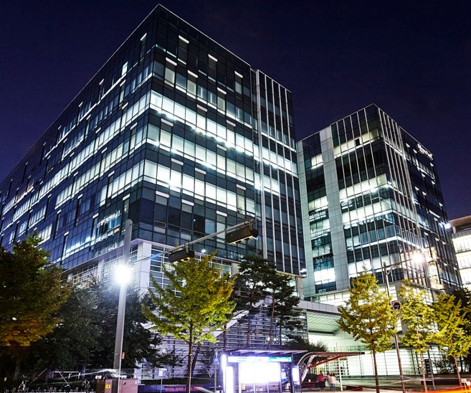
Financial
Performance
Financial Summary
Financial Structure
Shareholder Return

Slide 20
03. Financial Performance
Financial Summary
2Q26 Income Statement (Consolidated)
(Unit: KRW Million)
 | FY2025 |  |  |  | FY2026
 | 1Q | 2Q | 3Q | 4Q | 1Q | 2Q | QoQ | YoY
Revenue | 289,784 | 295,226 | 299,908 | 309,227 | 328,086 | 346,874 | 5.7% | 17.5%
Cost of Sales | 211,228 | 220,062 | 227,223 | 225,435 | 225,011 | 248,095 | 10.3% | 12.7%
Gross Profit | 78,555 | 75,164 | 72,685 | 83,792 | 103,076 | 98,779 | (4.2%) | 31.4%
SG&A | 30,780 | 32,477 | 32,313 | 42,177 | 36,483 | 39,488 | 8.2% | 21.6%
Operating Income | 47,775 | 42,687 | 40,372 | 41,615 | 66,593 | 59,291 | (11.0%) | 38.9%
Net Profit | 36,113 | 5,481 | 23,179 | 29,320 | 66,899 | 84,972 | 27.0% | N.M
Operating Income Margin | 16.5% | 14.5% | 13.5% | 13.5% | 20.3% | 17.1%
EPS (KRW) | 702 | 107 | 451 | 571 | 1,304 | 1,667
20 2026 Investor Relations

Slide 21
03. Financial Performance
Financial Summary
Financial Highlights
2Q26 Revenue :
+5.7% QoQ
2Q26 Operating Income :
-11.0% QoQ
2Q26 Net Profit :
+27.0% QoQ
Higher shipments of semiconductor
materials(PR & Thinner)
& FX Tailwinds(average FX rate:
KRW 1,464.66 → KRW 1,501.93 /USD)
- Increased raw material costs driven
by rising oil prices
- 1H bonus & incentive payouts
Valuation gains on marketable securities (Samsung Elec.), higher
FX gains, and lower corporate tax expense
(Unit: KRW Million)
21 2026 Investor Relations

Slide 22

03. Financial Performance
Financial Summary
In 3Q25, the Company decided to divest a 100% equity stake in its China subsidiaries held by the parent and its affiliates (with a contractual agreement to repurchase a 30% stake post-divestment).
In accordance with IFRS 1105 (Non-current Assets Held for Sale and Discontinued Operations), the related assets and liabilities were reclassified as held-for-sale, and the revenue and operating results of these entities were accounted for as discontinued operations in the official financial statements.
The consolidated financial figures below represent earnings prior to reflecting discontinued operations
(Unit: KRW Million)
 | 1Q25 | 2Q25 | 3Q25 | 4Q25 | 1Q26 | 2Q26
Revenue | 368,108 | 376,841 | 383,702 | 395,346 | 416,879 | 442,965
Operationg Income | 58,461 | 53,838 | 52,339 | 54,967 | 78,582 | 75,048
Net Profit | 36,113 | 5,481 | 23,179 | 29,320 | 66,899 | 84,972
22 2026 Investor Relations

Slide 23
03. Financial Performance
Financial Summary
Revenue Breakdown by Product(1H FY26)
(Unit: KRW Million)
※ 발포제 매출은 26년 1월 1일 기준 물적분할 된 신설법인의 매출입니다.
ITEM |  | AMOUNT | % | NOTES
Semicon ductor & Electronic Materials | PR | 193,106 | 28.61% | KrF, ArF, EUV Photoresist
 | WET Chemical | 200,717 | 29.74% | Thinner
 | Others | 56,603 | 8.39% | Slurry and Other
Display & Electronic Materials | Organic Insulating Layer | 56,809 | 8.42%
 | CR | 31,967 | 4.74%
 | WET Chemical | 35,929 | 5.32% | Stripper, Etchant
 | Others | 39,768 | 5.89% | Display PR
Energy Materials |  | 10,226 | 1.52% | Cathode CNT Conductive Additive
Others |  | 49,835 | 7.37% | Foaming Agents
Total |  | 674,960 | 100%
* Note: Foaming agent sales include revenue from the newly spun-off entity (effective Jan. 1, 2026)
23 2026 Investor Relations

Slide 24
03. Financial Performance
Financial Structure
Consolidated Statement of Financial Position
(Unit: KRW Million)
 | FY 2024 | FY 2025 | 2Q 2026
Current Assets | 1,082,971 | 1,130,911 | 1,278,442
Non-Current Assets | 934,018 | 875,219 | 997,574
Total Assets | 2,016,989 | 2,006,131 | 2,256,015
Current Liabilities | 722,769 | 579,367 | 822,877
Non-Current Liabilities | 273,790 | 325,183 | 190,776
Total Liabilities | 996,558 | 904,550 | 1,013,653
Total Equity | 1,020,431 | 1,101,581 | 1,242,362
Liabilities-to-Equity Ratio | 98% | 82% | 82%
Current Ratio | 150% | 195% | 155%
Current Liability-to-Equity Ratio | 71% | 53% | 66%
24 2026 Investor Relations

Slide 25
03. Financial Performance
Shareholder Return
Dividend Track Record
Treasury Stock Cancellation
Targeting a Sustained Dividend Payout Ratio of 25% or Higher
On December 8, 2025, the Company announced a KRW 20.0 billion share buyback program, and successfully completed the buyback in April 2026.
As of today, 100% of the acquired treasury
shares have been fully retired to enhance
shareholder value.
Category | FY2023 | FY2024 | FY2025
Par Value per Share (KRW) | 500 | 500 | 500
Consolidated Net Profit (KRW Mn) | 127,315 | 154,782 | 99,070
Separate Net Profit (KRW Mn) | 129,293 | 80,019 | 131,742
Total Cash Dividends (KRW Mn) | 6,170 | 10,283 | 33,400
Cash Dividend Per Share (KRW) - Common Stock | 120 | 200 | 650
Shareholder Return Strategy
  The Company is fully committed to enhancing shareholder value by expanding its cash dividend-focused shareholder return policy
25 2026 Investor Relations

Slide 26
Appendix
Executive Leadership & Management
ESG Management Overview
Shareholder Structure

Slide 27
Executive Leadership & Management
Title | Name | Education | Career
CEO | CHUN HYUK LEE | B.S. in Chemical Engineering, Seoul National University Ph.D. in Chemical Engineering, M.I.T. | Chairman & CEO, Dongjin Semichem Chairman, World Class 300 Association Vice Chairman, Korea Semiconductor Industry Association (KSIA) Board Member (Director), The National Academy of Engineering of Korea (NAEK)
President | SUNG IL KIM | B.S. in Electronic Engineering, Chung-Ang University | President & CEO, Dongjin Semichem Group Leader, Memory Business Division, Samsung Electronics
President | JAE HYUN KIM | M.S. in Fiber & Polymer Engineering, Seoul National University Ph.D. in Polymer Science and Engineering, University of Massachusetts Amherst | President, Dongjin Semichem
Independent Director | SEUNG JONG LEE | B.S. in Chemical Engineering, Seoul National University Ph.D. in Chemical Engineering, University of Delaware | Professor Emeritus, School of Chemical and Biological Engineering, Seoul National University Director, KDB Nanum Foundation
Standing Auditor | MYUNG JAE CHO | B.A. in Business / Commerce, College of Commerce, Seoul National University | Former CEO / Representative Director, LG Household & Health Care Chairman of the Board, LG Miso Microfinance
27 2026 Investor Relations

Slide 28
ESG Management Overview
Eco-Friendly Operations
& Sustainable Production for Tomorrow
For Sustainable Growth
Practicing Management Focused on
Eco-Friendliness, Social Responsibility, and Transparent Governance
Elimination of Hazardous Substances at Source
Minimizing Operational Environmental Impact
Pollutant & Emission Control
Waste Recycling & Reuse
Enterprise-Wide Energy & GHG Management
Eco-Friendly & Sustainable Manufacturing
Environmental
Responsibility
Customer Satisfaction, Local Community
& Partner Growth
Management Stability, Ethical
Management, Financial Integrity
Community Infrastructure Enhancement
Active Stakeholder Communication
Supplier Capacity Building & Shared Growth
Joint R&D & Future Tech Collaboration
Fair Trade & Ethical Business Practices
Social
Responsibility
Governance
Ethical Management System
External Audit of Internal Accounting Control System
ESG Strategy Task Force Team
Maintaining Stable Ownership to Ensure Management Continuity
28 2026 Investor Relations

Slide 29
Shareholder Ownership
Shareholder Register (As of June 30, 2026)
Shareholder | Number of Shares (2Q 2026) | Ownership (%)
Dongjin Holdings Co., Ltd. | 16,706,986 | 32.78%
Dongjin Scholarship & Research Foundation | 1,880,000 | 3.69%
Myungbu Industry Co., Ltd. | 633,678 | 1.24%
Yeon Su Ok | 210,560 | 0.41%
Sang Hee An | 206,500 | 0.41%
Others | 31,332,402 | 61.47%
TOTAL | 50,970,126 | 100.00%
29 2026 Investor Relations

Slide 30
THANK YOU

